Slide 1
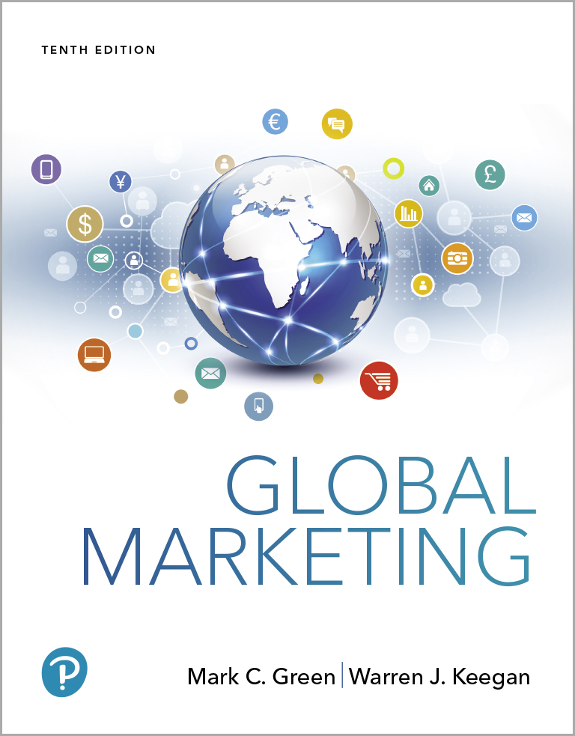
Global Marketing
Tenth Edition
Chapter 2
The Global Economic Environment
Copyright © 2020, 2017, 2015 Pearson Education, Inc. All Rights Reserved
Notes:
If this PowerPoint presentation contains mathematical equations, you may need to check that your computer has the following installed:
1) MathType Plugin
2) Math Player (free versions available)
3) NVDA Reader (free versions available)

Slide 2
Learning Objectives
2.1 Identify and briefly explain major changes in the world economy over the last 100 years
2.2 Compare and contrast types of economic systems that are found in the different regions of the world
2.3 Explain the stages of economic development used by the World Bank and identify the key emerging country markets at each stage of development
2.4 Discuss the significance of balance of payments for the world’s major economies
2.5 Identify the countries that are leading exporters
2.6 Briefly explain how exchange rates impact a company’s opportunities in different parts around the world

Slide 3
The World Economy-An Overview (1 of 3)
In the early 20th century economic integration was at 10%; today it is 50%
E U and N A F T A are very integrated
Global competitors have displaced or absorbed local ones
Notes:
Seventy-five years ago, the auto industry was very different. European automakers like Renault, Citroen, Peugeot, Morris, Volvo, and others produced vehicles radically different from those of American makers like Chevrolet, Ford, or Plymouth or Japanese autos made by Toyota or Nissan. Today, manufacturers make autos for home markets but are increasingly global companies with global products. In 2008, Ford Fiesta was introduced to world markets.

Slide 4
The World Economy-An Overview (2 of 3)
The new realities:
Capital movements have replaced trade as the driving force of the world economy
Production has become uncoupled from employment
The world economy, not individual countries, is the dominating factor
Notes:
The first change is the increased volume of capital movements. The dollar value of world trade in goods and services was $16.5 trillion in 2015. However, the Bank for International Settlements has calculated that foreign exchange transactions worth approximately $5 trillion are booked every day. This works out to more than $1 quadrillion annually, a figure that far surpasses the dollar value of world trade in goods and services.⁵ An inescapable conclusion resides in these data: Global capital movements far exceed the dollar volume of global trade. In other words, currency trading represents the world’s largest market.
GDP is calculated by adding consumer spending (C), investment spending (I), government purchases (G), and net exports (NX):C + I + G + NX = GDP
The second change concerns the relationship between productivity and employment. In the US, manufacturing share of GDP declined from 19.2% in 1989 to 13% in 2009. In 2011, manufacturing employed about 9% of the workforce; the figure was 26 percent. During that 40-year period, productivity has increased dramatically. Similar trends can be found in many other major industrial economies as well. In the United Kingdom, for example, manufacturing’s share of jobs is only 8 percent, compared with 24 percent in 1980.⁸ One recent study of 20 large economies found that between 1995 and 2002 more than 22 million factory jobs were eliminated. Manufacturing is not in decline—it is employment in manufacturing that is in decline.
The third change is the emergence of the world economy as the dominant economic unit. The real secret of economic success of Japan and Germany is that business leaders and policy makers focus on their countries’ competitive positions in world markets. This change has brought two questions to the fore: How does the global economy work, and who is in charge? Unfortunately, the answers to these questions are not clear cut.

Slide 5
The World Economy-An Overview (3 of 3)
The new realities, continued:
The struggle between capitalism and socialism began in 1917 is over
E-Commerce diminishes the importance of national barriers and forces companies to re-evaluate business models
Notes:
The fourth change is the end of the Cold War. The demise of communism as an economic and political system can be explained in a straightforward manner: Communism is not an effective economic system. The overwhelmingly superior performance of the world’s market economies has given leaders in socialist countries little choice but to renounce their ideology and introduce democratic reform.
The fifth change relates to e-commerce. The PC and the Internet have, in some ways, diminished the importance of national boundaries. 2/3 of American households have PCs. There are 600 million computers used worldwide.
Finally, the personal computer revolution and the advent of the Internet era have in some ways diminished the importance of national boundaries. Worldwide, an estimated 1 billion people use personal computers. In the so-called Information Age, barriers of time and place have been subverted by a transnational cyberworld that functions “24/7.” Amazon.com, eBay, Facebook, Google, Groupon, iTunes, Priceline, Twitter, and YouTube are just a few of the companies that are pushing the envelope in this brave new world.

Slide 6
Zeroing in on Economic Systems (1 of 3)
Globalization has made it harder to pigeonhole economies within the four-cell matrix
Also consider:
Type of economy: advanced industrial state, emerging or transition economy, or developing nation?
Notes:
Type of economy. Is the nation an advanced industrial state, an emerging economy, a transition economy, or a developing nation?

Slide 7
Zeroing in on Economic Systems (2 of 3)
Type of Government: Monarchy, dictatorship, tyrant? One-party system? Dominated by another state? Democracy? Terrorist?
Trade and capital flows: Free trade, part of trading bloc? Currency board or exchange controls?
The commanding heights: Transportation, communications & energy sectors. State, private, or mixed ownership?
Notes:
• Type of economy. Is the nation an advanced industrial state, an emerging economy, a transition economy, or a developing nation?
• Type of government. Is the nation ruled by a monarchy, a dictatorship, or a tyrant? Is there an autocratic, one-party system? Is the nation dominated by another state, or is it a democracy with a multiparty system? Is it an unstable or terrorist nation?
• Trade and capital flows. Is the nation characterized by almost completely free trade or incomplete free trade, and is it part of a trading bloc? Is there a currency board, or are there exchange controls? Is there no trade, or does the government dominate trade possibilities?
• The commanding heights (e.g., the transportation, communications, and energy sectors). Are these sectors state owned and operated? Is there a mix of state and private ownership? Are they all private, with or without controlled prices?

Slide 8
Zeroing in on Economic Systems (3 of 3)
Services provided by the state or state funded: Pensions, health care, education.
Institutions: Country characterized by transparency, standards, absence of corruption? Standards ignored and court system compromised?
Markets: Entrepreneurial high risk/high reward? Socialized market? Government dominated price and wage controls?
Notes:
• Services provided by the state and funded through taxes. Are pensions, health care, and education provided? Pensions and education but not health care? Do privatized systems dominate?
• Institutions. Is the nation characterized by transparency, standards, the absence of corruption, and the presence of a free press and strong courts? Or is corruption a fact of life and the press dominated by the government? Are standards ignored and the court system compromised?
• Markets. Does the nation have a free market system characterized by high-risk/high-reward entrepreneurial dynamism? Is it a free market that is dominated by monopolies, cartels, and concentrated industries? Is it a socialized market with cooperation among business, government, and labor (but with little entrepreneurial support)? Or is planning, including price and wage controls, controlled by the center?

Slide 9
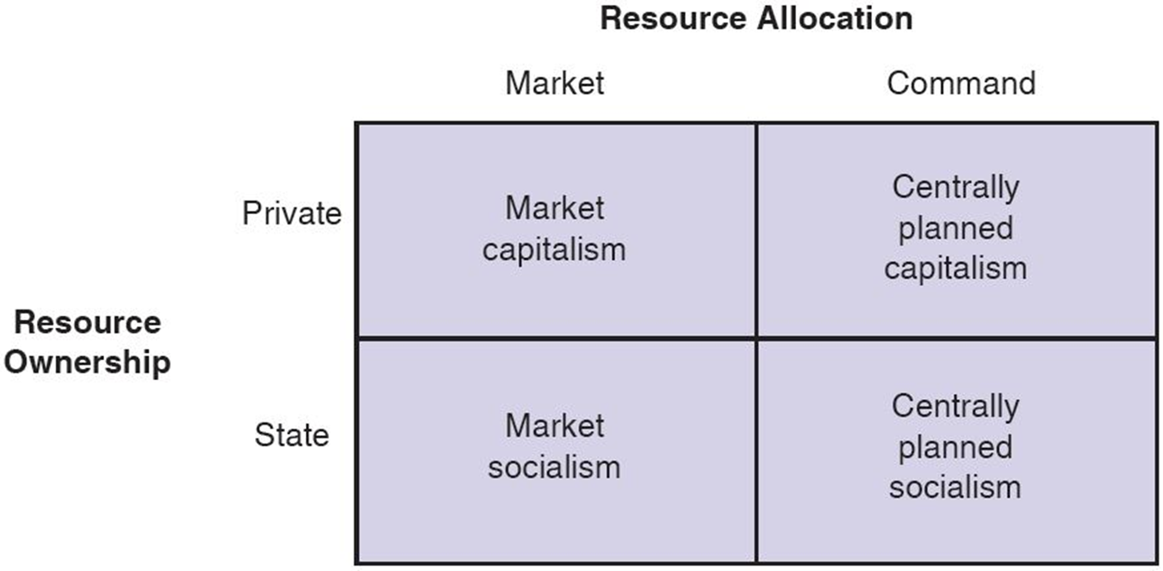
Figure 2-1 Economic Systems

Slide 10
Market Capitalism
Individuals and firms allocate resources
Production resources are privately owned
Driven by consumers
Government’s role is to promote competition among firms and ensure consumer protection
Notes:
Market capitalism is practiced around the world, most notably in Western Europe and North America. All market-oriented economies do not function in an identical manner. The U.S. is characterized by its competitive “free-for-all” and decentralized initiative. Japan is sometimes called “Japan, Inc.” because it has a tightly run, highly regulated economic system that is also market oriented.

Slide 11
Table 2-1 Western Market Systems
Type of System | Key Characteristics | Countries
Anglo-Saxon model | Private ownership; free enterprise economy; capitalism; minimal social safety net; highly flexible employment policies | United States, Canada, Great Britain
Social market economy model | Private ownership; “social partners” orientation that includes employer groups, unions, and banks; unions and corporations are involved in government, and vice versa; inflexible employment policies | Germany, France, Italy
Nordic model | Mix of state ownership and private ownership; high taxes; some market regulation; generous social safety net | Sweden, Norway
Notes:
Anglo saxon model : form of free marker economy that exists in rich English speaking nations.
Social market economy mode;
Nordic countries are five :- Norway, Sweden, Iceland, finland and Denmark
Welfare capitalist featuring a combination of free market activity and government intervention

Slide 12
Centrally Planned Socialism
Opposite of market capitalism
State holds broad powers to serve the public interest; decides what goods and services are produced and in what quantities
Consumers can spend only what is available
Government owns entire industries and controls distribution
Demand typically exceeds supply
Little reliance on product differentiation, advertising, pricing strategy
China, India, and the former U S S R now moving towards some market allocation and private ownership
Notes:
“Marxism is utterly vanquished, if not yet entirely extinct, as an alternative economic system. Capitalism is triumphant. The ideological conflict first joined in the mid-nineteenth century in response to the rise of industrial capitalism, the deep argument that has preoccupied political imagination for 150 years, is ended.”
Willian Greidner, One World, Ready or Not: the Manic Logic of Global Capitalism
For decades, the economies of China, the former Soviet Union, and India functioned according to the tenets of centrally planned socialism. All three countries are now engaged in economic reforms characterized, in varying proportions, by increased reliance on market-allocation and private ownership. Even as China’s leaders attempt to maintain control over society, they acknowledge the importance of economic reform. At a recent assembly, the Chinese Communist Party said that reform “is an inevitable road for invigorating the country’s economy and promoting social progress, and a great pioneering undertaking without parallel in history.”

Slide 13
Centrally Planned Capitalism
Economic system in which command resource allocation is used extensively in an environment of private resource ownership
Example:
Swedish government controls 2/3 of all spending; a hybrid of C P S and capitalism (Market Socialism)
Swedish government plans move towards privatization
Notes:
In reality, market capitalism and centrally planned socialism do not exist in “pure” form. In most countries, to a greater or lesser degree, command and market resource allocation are practiced simultaneously, as are private and state resource ownership. The role of government in modern market economies varies widely.
In Sweden, where 2/3 of all expenditures are controlled by the government, resource allocation is more “voter” oriented than “market” oriented. Sweden’s “welfare state” has a hybrid system that has elements of both centrally planned socialism and capitalism. Swedish gov’t ownership: TeliaSonera, telecom, 45%; Nordea, banking, 20%, OMX stock exchange, 7%, SAS airline, 21%; Vin & Spirit alcohol was 100% government owned until it was sold to France’s Pernod Ricard in 2008.
China’s Guangdong Province operates within a market system. China’s private sector accounts for 75% of total national output.

Slide 14
Stages of Market Development
The World Bank has defined four categories of development using Gross National Income (G N I) as a base
B E Ms, identified 10 years ago, were countries in Central Europe, Latin America, and Asia that were to have rapid economic growth
Today, the focus is on B R I C S: Brazil, Russia, India, China, and South Africa
Notes:
Although the income definition for each of the stages is arbitrary, countries within a given category generally have a number of characteristics in common. Thus, the stages provide a useful basis for global market segmentation and target marketing.
BRICS nations are expected to be key players in global trade even as their track records on human rights, environmental protection, and other issues are scrutinized by their trading partners. The BRICS government leaders will also come under pressure at home as their developing market economies create greater income disparity.

Slide 15
Economic Freedom
Rankings of economic freedom among countries
“free” “mostly free” “mostly unfree” “repressed”
Variables considered include such things as:
Trade policy
Taxation policy
Capital flows and foreign investment
Banking policy
Wage and price controls
Property rights
Black market
Notes:
The Washington D.C. Heritage Foundation, a conservative think tank, ranks countries by the degree of economic freedom they support. There is a high correlation between the degree of economic freedom and the extent to which a nation’s mixed economy is heavily market oriented. A number of key economic variables are considered: trade policy, taxation policy, government consumption of economic output, monetary policy, capital flows and foreign investment, banking policy, wage and price controls, property rights, regulations, and the black market. Hong Kong and Singapore are ranked first and second in terms of economic freedom; Venezuela, Cuba, and North Korea are ranked lowest (see Exhibit 2-3).
The authoritarian state capitalism of Singapore deprives the nation’s citizens of free speech, a free press, and free assembly. In 1992, the government banned the import, manufacture, and sale of chewing gum because discarded gum made a mess on public property. Even though gum is now for sale in pharmacies, consumers must register their names and addresses before making a purchase. Singapore’s citizens are comfortably provided for by a government that administers paranoid control over press and politics and they are well housed and fed, but they are not free. This example shows that some aspects of “free economies” bear little more than a passing resemblance to command-style economic systems.

Slide 16
Economic Freedom-2017 Rankings
Free
Hong Kong
Singapore
New Zealand
Australia
Switzerland
Repressed
Turkmenistan
Djibouti
Algeria
Timor-Leste
Equatorial Guinea
Zimbabwe
Eritrea
Republic of Congo
Cuba
Venezuela
North Korea
Mostly Free
Estonia
Canada
United Arab Emirates
Ireland
Chile
United States
Not ranked: Iraq, Libya, Liechtenstein, Somalia, Syria, Yemen
Notes:
The website for The Heritage Foundation is http://www.heritage.org/index

Slide 17
Low-Income Countries
GNI per capita of $1,005 or less
Characteristics
Limited industrialization
High percentage of population in farming
High birth rates
Low literacy rates
Heavy reliance on foreign aid
Political instability and unrest
Concentrated in Sub-Saharan Africa
Notes:
Includes 9% of the world’s population.
Many low-income countries have such serious economic, social, and political problems that they represent extremely limited opportunities for investment and operations. Some are no-growth economies, such as Burundi and Rwanda, with a high percentage of the population living at the national poverty line. Others were once relatively stable countries with growing economies that have become divided by political struggles. The result is an unstable environment characterized by civil strife, flat income, and considerable danger to residents. Countries embroiled in civil wars are dangerous areas; most companies find it prudent to avoid them.
Other low-income countries have rebounded sharply after years of ethnic turmoil and internal strife. For example, Rwanda’s per-capita GNI increased 100 percent in the decade from 2006 to 2016. President Paul Kagame is investing heavily to bring about economic transformation. A new convention center in Kigali is designed to lure business to the capital city and increase tourism to the country overall (see Exhibit 2-4). Kagame has laid out an ambitious growth agenda dubbed Vision 2050, and he envisions raising the country’s per capita income to $4,035 by 2035. Critics have noted that government-linked businesses known as “partystatals” dominate some industry sectors in Rwanda; however, the president denies that his ruling Rwandan Patriot Front is trying to take over the economy.

Slide 18
Lower-Middle-Income Countries
G N I per capita: $1,006 to $3,955
Characteristics
Rapidly expanding consumer markets
Cheap motivated labor
Mature, standardized, labor-intensive industries like footwear, textiles, and toys
50 bottom-ranked countries are L D Cs-least developed countries
India is the only B R I C S nation
Tajikistan and Uzbekistan may be opportunities for economic growth
Notes:
With a 2009 GNI per capita of $1,680, India has transitioned out of the low-income category and now is classified as a lower-middle-income country. In 2017, India commemorated the 70th anniversary of its independence from Great Britain. For many decades, economic growth was weak. As the 1990s began, India was in the throes of an economic crisis: Inflation was high, and foreign exchange reserves were low. Country leaders opened India’s economy to trade and investment and dramatically improved market opportunities.
Manmohan Singh, former governor of the Indian central bank and finance minister, KSA Technopak, India, believed that India had been taking the wrong road. Accordingly, he set about dismantling the planned economy by eliminating import licensing requirements for many products, reducing tariffs, making DFI easier, and liberalizing the rupee.
Two of the smaller countries from the former Soviet Union, Tajikistan and Uzbekistan, also fall into the lower-middle income categories. Sometimes lumped into a regional group known as “the Stans,” they invite closer study on both an individual and regional basis. Incomes in these countries are low, there is considerable economic hardship, and the potential for disruption is certainly high. Are they problem cases, or are they attractive opportunities with good potential for economic growth? These countries represent an obvious risk–reward trade-off; some companies have taken the plunge, but many others are still assessing whether they ought to join the pioneers.
Table 2-3 ranks Uzbekistan quite low in terms of economic freedom. This is one indication of a risky business environment in a lower-middle-income country. Perhaps that helps explain why there are no Western fast-food chains in Uzbekistan—no Starbucks, no McDonald’s! The good news is that, in the last few years, Uzbekistan has transitioned from “repressed” in the index to “mostly unfree.” And, as befits a nation whose cities were once important trade hubs on the Silk Road, there are market opportunities here. For example, GM is the top car company in Uzbekistan; in 2013, GM Uzbekistan produced its two-millionth car. Overall, this Central Asian country is one of GM’s 10 largest markets worldwide! Moreover, Uzbekistan stands to gain from China’s infrastructure investment in neighboring Kazakhstan.

Slide 19
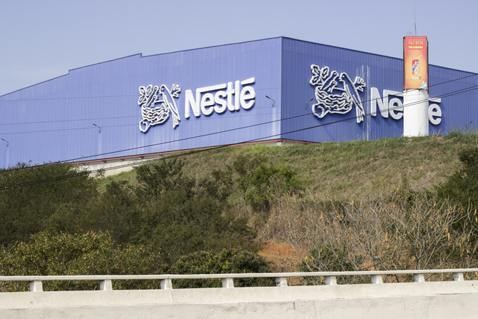
Upper-Middle-Income Countries
GNP per capita: $3,956 to $12,235
Characteristics:
Rapidly industrializing, less agricultural employment
Increasing urbanization
Rising wages
High literacy rates and advanced education
Lower wage costs than advanced countries
Nestle invested $83 billion for this plant in Brazil and millions more around the country.
B R I C S: Brazil, Russia, China, South Africa
Notes:
Brazil is the largest country in Latin America in terms of the size of its economy, population, and geographic territory. Brazil also boasts the richest reserves of natural resources in the hemisphere; China, Brazil’s top trading partner, has an insatiable appetite for iron ore and other commodities. Government policies aimed at stabilizing Brazil’s macroeconomy have yielded impressive results: Brazil’s GNI grew steadily between 2003 and 2013. During the same time period, tens of millions of Brazilians joined the middle class as incomes and living standards have risen. Needless to say, this trend has been a boon to global companies doing business in Brazil which include Electrolux, Fiat, Ford, General Motors, Nestlé, Nokia, Raytheon, Toyota, Unilever, and Whirlpool.
Typical of countries at this stage of development, Brazil is a study in contrasts. Grocery distribution companies use logistics software to route their trucks; meanwhile, horse-drawn carts are still a common sight on many roads. To keep pace with the volatile financial environment of the early 1990s, many local retailers invested in sophisticated computer and communications systems. They use sophisticated inventory management software to maintain financial control. Thanks to Brazil’s strength in computers, the country’s outsourcing sector is growing rapidly. Former French president Jacque Chirac underscored Brazil’s importance on the world trade scene when he noted, “Geographically, Brazil is part of America. But it’s European because of its culture and global because of its interests.”
China is a case study in how to jump-start a nation’s economic growth. Leveraging the country’s central planning economic model, the government poured money into infrastructure improvements such as highways, railways, and ports. Soon, China’s economy was growing at a double-digit pace. The beneficiaries of this economic boom included companies in Australia, Brazil, Indonesia, and other countries that export goods to China. Avon, Coca-Cola, Dell, Ford, General Motors, Honda, HSBC, JPMorgan Chase, McDonald’s, Motorola, Procter & Gamble, Samsung, Siemens AG, Toyota, and Volkswagen were among the scores of global companies that began actively pursuing opportunities in China.

Slide 20
Newly Industrializing Economies (N I Es)
Lower-middle and upper income economies with the highest sustained rates of economic growth
Greater industrial output than developing economies
Exports of manufactured and refined products
Next -11 (N-11) a new country grouping identified by Goldman Sachs
N I Es include Egypt, Indonesia, the Philippines, (lower-middle income) Mexico, and Turkey (upper-middle income)

Slide 21
Mistaken Assumptions about B O P
The poor have no money.
The poor are too concerned with basic needs to “waste” money on non-essential goods.
Entering developing markets is fruitless because goods there are too cheap to make a profit.
People in B O P (bottom of the pyramid) countries cannot use technology.
Global companies doing business in B O P countries will be criticized for exploiting the poor.
Notes:
In the aggregate, the buying power of poor communities can be substantial. In rural Bangladesh, villagers spend considerable sums to use village phones operated by local entrepreneurs.
Poor consumers buy TVs and gas stoves to improve their lives.
Poor people often pay higher prices. There is an opportunity for efficient competitors to realize attractive margins by offering quality and low prices.
Rural residents can and do learn to use cell phones, PCs, and other devices.
Informal economies in many poor countries are highly exploitive. A global company can improve a country’s standard of living while earning a reasonable ROI.
Ask students to think of low income areas in the U.S.—urban or rural—and apply these assumptions. Yes, the poor do buy cell phones and Air Jordans and 50” high def televisions.
Despite the difficult economic conditions in parts of Southeast Asia, Latin America, Africa, and Eastern Europe, many nations in these regions will evolve into attractive markets. One of marketing’s roles in developing countries is to focus resources on the task of creating and delivering products that are best suited to local needs and incomes. Appropriate marketing communications techniques can also be applied to accelerate acceptance of these products.
The role of marketing—to identify people’s needs and wants and to focus individual and organizational efforts to respond to those needs and wants—is the same in all countries, irrespective of the level of economic development. When global marketers respond to the needs of rural residents in emerging markets such as China and India, they are also more likely to gain all-important government support and approval.
For example, pursuing alternative energy sources is important for two reasons: the lack of coal reserves in many countries and the concerns that heavy reliance on fossil fuels contribute to global warming. Similarly, people everywhere need affordable, safe drinking water. Recognizing this fact, Nestlé launched Pure Life bottled water in Pakistan. The price was set at about 35 cents a bottle, and advertising promised, “Pure safety. Pure trust. The ideal water.” Pure Life quickly captured 50 percent of the bottled water market in Pakistan; the brand has since been rolled out in dozens of other low-income countries. The Coca-Cola Company recently began to address dietary and health needs in low-income countries by developing Vitango, a beverage product that can help fight anemia, blindness, and other ailments related to malnutrition.
There is also an opportunity to help developing countries join the Internet economy. Intel Chairman Craig Barrett has been visiting villages in China and India and launching programs to provide Internet access and computer training. One aspect of Intel’s World Ahead initiative is the development of a $550 computer that is powered by a car battery. Similarly, Hewlett-Packard engineers are working to develop solar-powered communication devices that can link remote areas to the Internet.

Slide 22
High-Income Countries (1 of 2)
G N I per capita: $12,236 or more
Also known as advanced, developed, industrialized, or postindustrial countries
Characteristics:
Sustained economic growth through disciplined innovation
Households have extremely high ownership levels of basic products
Notes:
The phrase postindustrial countries was first used by Daniel Bell of Harvard to describe the United States, Sweden, Japan, and other advanced, high-income societies. In his 1973 book The Coming of the Post-Industrial Society, Bell drew a distinction between the industrial and the postindustrial stages of country development that went beyond mere measures of income. Bell’s thesis was that the sources of innovation in postindustrial societies are derived increasingly from the codification of theoretical knowledge rather than from “random” inventions. The service sector accounts for more than half of national output, the processing and exchange of information becomes increasingly important, and knowledge trumps capital as the key strategic resource.
Product and market opportunities in a postindustrial society are more heavily dependent upon new products and innovations than in industrial societies. Ownership levels of basic products are extremely high in most households. When it is difficult to expand market share, companies must bring new products to market or create new markets for products.
South Korea was upgraded in 2009 to a developed society. South Korea is home to Samsung Electronics, LG Group, Kia Motors Corporation, Daewoo Corporation, Hyundai Corporation, and other well-known global enterprises. In place of substantial barriers to free trade, South Korea has initiated major reforms in its political and economic system in response to the “Asian flu.” Even so, investors note the political risk posed by North Korea. Another concern is inconsistent treatment of foreign investors by the government. For example, authorities recently raided the local offices of French retailer Carrefour.

Slide 23
High-Income Countries (2 of 2)
Characteristics, continued:
Importance of information processing and exchange
Ascendancy of knowledge over capital, intellectual over machine technology, scientists and professionals over engineers and semiskilled workers
Future oriented
Importance of interpersonal relationships

Slide 24

G-7, The Group of Seven
Goal of global economic stability and prosperity
U.S.
Japan
Germany
France
Britain
Canada
Italy
N G Os often protest at meetings of world leaders, like at the G-7.
Notes:
As of 2007, the U.S. State Department website with G-8 information is http://usinfo.state.gov/ei/economic_issues/group_of_8.html
G-7 began in 1975 and Russia joined in 1998. The EU is also represented at all meetings.
The leader of the host country is the president of the G-8. The group meets every summer. The Presidency of the G8, and responsibility of hosting all G8 meetings, rotates each year, with the order of G8 Presidencies as follows:
2004 United States 2005 United Kingdom 2006 Russia 2007 Germany 2008 Japan 2009 Italy 2010 Canada 2011 France 2012 United States
2013 Great Britain

Slide 25
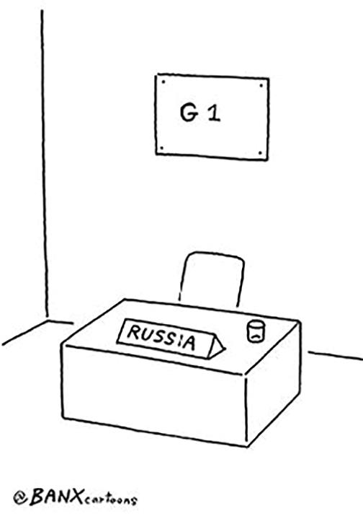
Russian Memberships
Russia joined in 1998, changing the group to the G-8 but its membership was suspended in 2014 after it annexed the Crimean peninsula.
It remains a member of G-20.

Slide 26
G-20, Group of Twenty
Established in 1999
Finance Ministers and central bank governors of 19 countries and the E U
Includes developing nations like Argentina, Brazil, India, Indonesia, Turkey
Russia remains a member, unlike in the G-7.
Notes:
Member nations are Argentina, Australia, Brazil, Canada, China, France, Germany, India, Indonesia, Italy, Japan, the Republic of Korea, Mexico, Russia, Saudi Arabia, South Africa, Turkey, the United Kingdom, the United States of America plus the European Union, which is represented by the President of the European Council and by Head of the European Central Bank.

Slide 27
O E C D, The Organisation for Economic Cooperation and Development
35 nations
Post-
European origin; based in Paris
Canada, U.S. (1961), Japan (1964)
Promotes economic growth and social well-being
Focuses on world trade, global issues, labor market deregulation
Anti-bribery conventions
Notes:
www.oecd.org
The 35 nations that belong to the OECD believe in market-allocation economic systems and pluralistic democracy. The organization has been variously described as an “economic think tank” and a “rich-man’s club”; in any event, the OECD’s fundamental task is to “enable its members to achieve the highest sustainable economic growth and improve the economic and social well-being of their populations.” Today’s organization is based in Paris and evolved from a group of European nations that worked together after World War II to rebuild the region’s economy. Canada and the United States have been members since 1961; Japan joined in 1964. Evidence of the increasing importance of the BRICS group is the fact that Brazil, Russia, India, and China have all formally announced their intention to join the OECD. Applicants must demonstrate progress toward economic reform.
Representatives from OECD member nations work together in committees to review economic and social policies that affect world trade. The secretary-general presides over a council that meets regularly and has decision-making power. Committees of specialists from member countries provide a forum for discussion of trade and other issues. Consultation, peer pressure, and diplomacy are the keys to helping member nations candidly assess their own economic policies and actions. The OECD publishes country surveys and an annual economic outlook. Recently, the OECD has become more focused on global issues, social policy, and labor market deregulation. For example, the OECD has addressed the vexing problem of bribery; in 1997, it passed a convention that requires members to cooperate when pursuing bribery allegations. In the 15+ years since the agreement entered into force, Germany, France, and other countries have adopted anti-bribery laws. Prosecutors from various countries are doing a better job of collaborating across borders; one case against Siemens AG resulted in a record ($1.6 billion) fine.

Slide 28
Product Saturation Levels
The percentage of potential buyers or households who own a product
India: 700 million debit cards but only 700,000 retailers with card readers
Card readers: 1 machine per 119 in Europe; 1 reader per 25 people in the U S; 1 per 60 in China
Autos: 8 per 1,000 Indians, 200 per 1,000 in Russia, 565 per 1,000 in Germany
Notes:
The stages of economic development can serve as a guide to marketers in evaluating product saturation levels. In low per-capita income countries, levels are likely to be low.
The stages of economic development described previously can serve as a guide to marketers in evaluating product saturation levels, or the percentage of potential buyers or households who own a particular product. George David is CEO of United Technologies; its business units include Otis Elevators. The CEO explains the significance of product saturation to his business as follows:
We measure elevator populations in countries as units installed per thousand people. And in China, the number today is about one half an elevator per thousand people. In most countries of the world outside of the U.S., people live in elevator and storied apartment houses. It’s true all over Europe, all over Asia, South America, certainly true in China. And in a mature market like Europe, the installed population is about six elevators per thousand people. And so we’re on our way to some portion of six.

Slide 29
Balance of Payments
Record of all economic transactions between the residents of a country and the rest of the world
Current account -record of all recurring trade in merchandise and services, and humanitarian aid
trade deficit -negative current account
trade surplus -positive current account
Capital account -record of all long-term direct investment, portfolio investment, and capital flows
Notes:
The balance of payments is divided into the current and the capital accounts. The current account is a broad measure that includes merchandise trade (i.e., manufactured goods) and services trade (i.e., intangible, experience-based economic output) plus certain categories of financial transfers such as humanitarian aid. A country with a negative current account balance has a trade deficit; that is, the outflow of money to pay for imports exceeds the inflow of money from sales of exports. Conversely, a country with a positive current account balance has a trade surplus. The capital account is a record of all long-term direct investment, portfolio investment, and other short- and long-term capital flows.

Slide 30
Table 2 - 7 Top Exporters and Importers in World Merchandise Trade, 2015 (U S$ Billions)
Leading Exporters | 2015 | Leading Importers | 2015
China | $2,274 | 1. United States | $ 2,308
2. United States | 1,504 | 2. China | 1,681
3. Germany | 1,329 | 3. Germany | 1,050
4. Japan | 624 | 4. Japan | 648
5. Netherlands | 567 | 5. United Kingdom | 625
Notes:
Thanks in part to the achievements of the General Agreement on Tariffs and Trade (GATT) and the WTO, world merchandise trade has grown at a faster rate than world production since the end of World War II. Put differently, import and export growth has outpaced the rate of increase in GNI. According to figures compiled by the WTO, the dollar value of world merchandise trade in 2015 totaled $16.5 trillion, a modest downturn after several years of growth as trade recovered to pre–economic crisis levels.

Slide 31
Overview of International Finance (1 of 3)
Foreign exchange allows companies to do business globally with different currencies
Exchange risk occurs when the value of a currency changes as it is traded
Spot market: immediate delivery
Forward market: future delivery
Currency market participants include countries’ central banks, companies that convert foreign currency into their home currencies, currency speculators
Notes:
The foreign exchange market consists literally of a buyer’s and a seller’s market where currencies are traded for both spot and future delivery on a continuous basis. As noted earlier in the chapter, $5 trillion in currencies is traded every day. The spot market is for immediate delivery; the market for future delivery is called the forward market. This is a true market where prices are based on the combined forces of supply and demand that come into play at the moment of any transaction.
Who are the participants in this market? First, a country’s central bank can intervene in currency markets by buying and selling currencies and government securities in an effort to influence exchange rates. Recall that China currently holds trillions of dollars in U.S. treasury securities. Such purchases help ensure that China’s currency is relatively weak compared to the U.S. dollar. Second, some of the trading in the foreign exchange market takes the form of transactions needed to settle accounts for the global trade in goods and services. For example, because Porsche is a German company, the dollars spent on Porsche automobiles by American car buyers must be converted to euros. Finally, currency speculators also participate in the foreign exchange market.

Slide 32
Overview of International Finance (2 of 3)
Devaluation: the reduction of a nation’s currency against other currencies
Mercantilism or Competitive-currency politics: Countries do not allow their currency to fluctuate
Revaluation: a nation allows its currency to strengthen
Notes:
Devaluation can result from government action or an economic crisis; whatever the cause, devaluation is reduction in the value of a nation’s currency against other currencies. For example, in August 1998 the Russian economy imploded. The ruble plunged in value, and the government defaulted on its foreign debt obligations. Many Russians faced wage cuts and layoffs; savings were wiped out as banks collapsed. In the decade that followed, however, Russia’s economy made a rapid recovery. Real GDP doubled, in part because import price increases caused by the ruble’s devaluation stimulated local production. As one economist noted, “The crash of ’98 really cleaned out the macroeconomy.” However, in 2014 it was “déjà vu all over again.” As world oil prices crashed below $50 per barrel, the ruble was in free fall once again.
During the past few years, the Chinese government has been criticized for keeping China’s currency undervalued to support exports. Faced with escalating rhetoric from Washington and elsewhere, Beijing has responded by adopting a policy of revaluation. What effect would a stronger Chinese currency have? The impacts would be felt both domestically and globally. In the broadest sense, a stronger renminbi (or yuan, as the Chinese currency is called) should help rebalance the global economy. In other words, China’s economic growth would be less dependent on the United States and other countries continuing to snap up its exports. Chinese consumers and companies would enjoy increased purchasing power as imported goods became more affordable. This would put downward pressure on China’s consumer price index, helping Beijing meet its goal of keeping inflation under control. Global automakers such as BMW, General Motors, and Volkswagen that assemble cars in China from imported parts would reap the benefits of lower costs.

Slide 33
Overview of International Finance (3 of 3)
Foreign exchange makes it possible to do business across the boundary of a national currency
Currency of various countries are traded for both immediate (spot) and future (forward) delivery
Currency risk adds turbulence to global commerce
Notes:
Foreign exchange makes it possible for a company in one country to conduct business in other countries with different currencies. However, foreign exchange is an aspect of global marketing that involves certain financial risks, decisions, and activities that are completely different from those facing a domestic marketer. Moreover, those risks can be even higher in developing markets such as Thailand, Malaysia, and South Korea. When a company conducts business within a single country or region with customers and suppliers paying in the same currency, there is no exchange risk. All prices, payments, receipts, assets, and liabilities are in the given currency. However, when conducting business across boundaries in countries with different currencies, a company is thrust into the turbulent world of exchange risk.

Slide 34
Foreign Exchange Market Dynamics
Supply and Demand interaction
Country sells more goods/services than it buys
There is a greater demand for the currency
The currency will appreciate in value
Table 2 - 8 Exchange Risks and Gains in Foreign Transactions
Blank | $1,000,000 Contract | $1,000,000 Contract | €1,100,000 Contract | €1,100,000 Contract
Foreign Contract Exchange Rates | U.S. Seller Receives | European Buyer Pays | U.S. Seller Receives | European Buyer Pays
€1.25 = $1 | $1,000,000 | €1,250,000 | $880,000 | €1,100,000
€1.10 = $1 | $1,000,000 | €1,100,000 | $1,000,000 | €1,100,000
€1.00 = $1 | $1,000,000 | €1,000,000 | $1,100,000 | €1,100,000
€0.85 = $1 | $1,000,000 | €850,000 | $1,294,118 | €1,100,000
Notes:
Devaluation can result from government action that decrees a reduction of the local currency against other currencies. In 1994, the Chinese devalued the yuan to ensure the low-cost position of Chinese exporters. Thailand, Malaysia, and Indonesia followed suit. In 2005, the Chinese folded to pressure to revalue the yuan. A stronger yuan would reduce the trade surplus with the U.S. Many experts believe that the yuan is still undervalued.
Devaluation can result from government action or an economic crisis; whatever the cause, devaluation is reduction in the value of a nation’s currency against other currencies. For example, in August 1998 the Russian economy imploded. The ruble plunged in value, and the government defaulted on its foreign debt obligations. Many Russians faced wage cuts and layoffs; savings were wiped out as banks collapsed. In the decade that followed, however, Russia’s economy made a rapid recovery. Real GDP doubled, in part because import price increases caused by the ruble’s devaluation stimulated local production. As one economist noted, “The crash of ’98 really cleaned out the macroeconomy.”

Slide 35
Managing Economic Exposure (1 of 2)
Economic exposure refers to the impact of currency fluctuations on the present value of the company’s financial performance.
Occurs when sales are in a foreign currency
Nestlé generates 98% of sales outside home country
Euro zone companies GlaxoSmithKline, Daimler A G, B P, for example, generate 1/3 of sales in the U.S.
Notes:
The degree to which exchange rates affect a company’s market value as measured by its stock price is known as economic exposure.
Among countries in the euro zone, GlaxoSmithKline, Daimler AG, BP, Sanofi-Aventis, Royal Dutch Shell, and AstraZeneca all generate more than one-third of total sales in the U.S. market. Given the volatility of the dollar relative to the euro, all of these companies face potential economic exposure. Conversely, GE generates 45 percent of its revenues in the domestic U.S. market and only 14 percent in Europe, so the relative extent of GE’s exposure is less than that of the European companies just listed. Even so, GE does face economic exposure. For example, in a 2014–2015 Securities and Exchange Commission filing, the company noted, “The effects of a stronger U.S. dollar compared to mainly the euro, Brazilian real, and Canadian dollar, decreased consolidated revenues by $4.9 billion.”
In dealing with the economic exposure introduced by currency fluctuations, a key issue is whether the company can use price as a strategic tool for maintaining its profit margins. Can the company adjust prices in response to a rise or fall of foreign exchange rates in various markets? That depends on the price elasticity of demand. The less price-sensitive the demand, the greater the flexibility a company has in responding to exchange rate changes. In the late 1980s, for example, Porsche raised prices in the United States three times in response to the weak dollar. The result: Porsche’s U.S. sales dropped precipitously, from 30,000 vehicles in 1986 to 4,500 vehicles in 1992.
Clearly, U.S. luxury car buyers were exhibiting elastic demand curves for pricey German sports cars!

Slide 36
Managing Economic Exposure (2 of 2)
Numerous techniques and strategies have been developed to reduce exchange rate risk
Hedging involves balancing the risk of loss in one currency with a corresponding gain in another currency
Forward Contracts set the price of the exchange rate at some point in the future to eliminate some risk
Notes:
Hedging is common among global companies.
Hedging exchange rate exposure involves establishing an offsetting currency position such that the loss or gain of one currency position is offset by a corresponding gain or loss in some other currency. The practice is common among global companies that sell products and maintain operations in different countries. Today, for example, Porsche relies on currency hedging rather than price increases to boost pretax profits on sales of its automobiles. Porsche manufactures all of its cars in Europe, but generates about 45 percent of its sales in the United States. Thus, Porsche faces economic exposure stemming from the relative value of the dollar to the euro. Porsche is “fully hedged”; that is, it takes currency positions to protect all earnings from foreign exchange movements.
If company forecasts indicate that the value of the foreign currency will weaken against the home currency, it can hedge to protect against potential transaction losses. Conversely, when it is anticipated that the foreign currency will appreciate (strengthen) against the home currency, then a gain, rather than a loss, can be expected on foreign transactions when revenues are converted into the home currency. Given this expectation, the best decision may be not to hedge at all. (The operative word is “may”; many companies hedge anyway unless management is convinced the foreign currency will strengthen.) Porsche has profited by (correctly) betting on a weak dollar.
30-, 60-, and 180-day forward prices of many currencies are quoted daily in publications like the Wall Street Journal, Financial Times, or www.ozforex.com.

Slide 37

Copyright
This work is protected by United States copyright laws and is provided solely for the use of instructors in teaching their courses and assessing student learning. Dissemination or sale of any part of this work (including on the World Wide Web) will destroy the integrity of the work and is not permitted. The work and materials from it should never be made available to students except by instructors using the accompanying text in their classes. All recipients of this work are expected to abide by these restrictions and to honor the intended pedagogical purposes and the needs of other instructors who rely on these materials.

